Slide 1
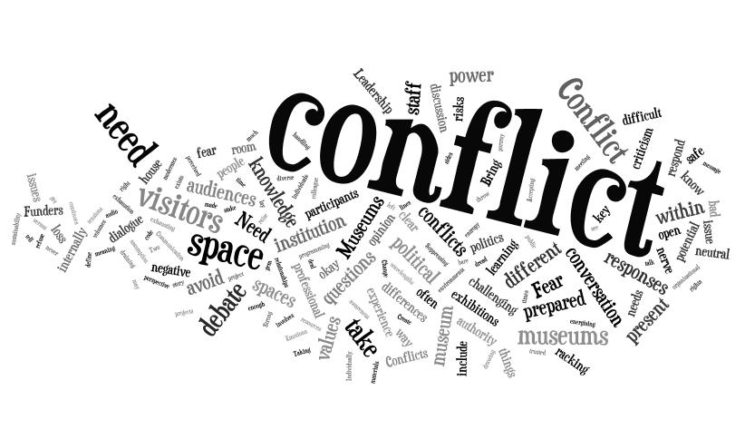
Conflict management

Slide 2
Conflict is classified into the following four types
Interpersonal conflict refers to a conflict between two individuals. This occurs typically due to how people are different from one another. When interpersonal conflict gets too destructive, calling in a mediator would help so as to have it resolved.
Intrapersonal conflict occurs within an individual. The experience takes place in the person’s mind.
Intragroup conflict is a type of conflict that happens among individuals within a team. The incompatibilities and misunderstandings among these individuals lead to an intragroup conflict
Intergroup conflict takes place when a misunderstanding arises among different teams within an organization

Slide 3
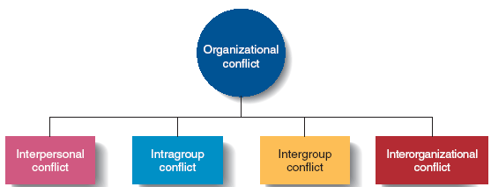

Slide 4
Sources of conflict
There are many causes or reasons for conflict in any work setting. Some of the primary causes are:
Poor Communication: different communication styles can lead to misunderstandings between employees or between employee and manager. Lack of communication drives conflict ‘underground’.

Slide 5
Different Values: any workplace is made up of individuals who see the world differently. Conflict occurs when there is a lack of acceptance and understanding of these differences.
Differing Interests: conflict occurs when individual workers ‘fight’ for their personal goals, ignoring organizational goals and organizational well-being.

Slide 6
Scarce Resources: too often, employees feel they have to compete for available resources in order to do their job. In a resource scarce environment, this causes conflicts – despite awareness of how scarce resources may be.
Personality Clashes: all work environments are made up of differing personalities. Unless colleagues understand and accept each other’s approach to work and problem-solving, conflict will occur.
Poor Performance: when one or more individuals within a work unit are not performing - not working up to potential – and this is not addressed, conflict is inevitable.

Slide 7
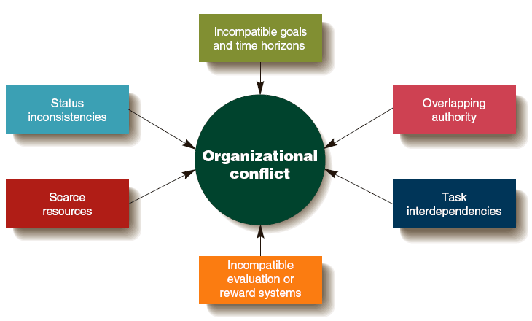

Slide 8
How would you help solve this conflict?
Chris and Kelly have been friends for 10 years and have always spent a lot of time with each other. Chris recently became upset when Kelly started hanging out with other kids at school. Today at school, Chris heard a group of students say that Kelly doesn’t like Chris any more. Chris became angry and went to find Kelly. You are a classmate of Chris and Kelly’s, but you don’t know them well. You are standing nearby and see Chris march up to Kelly and say, “I hate you! You never do things with me anymore. I thought you were my friend!” Kelly replied by saying, “What do you mean? I’ve always been your friend.” Chris said, “Don’t you lie to me!” Chris and Kelly continue to argue.

Slide 9
Conflict Management Strategies
Compromise
each party is concerned about their goal accomplishment and is willing to engage in give-and-take exchange to reach a reasonable solution.

Slide 10
Collaboration
parties try to handle the conflict without making concessions by coming up with a new way to resolve their differences that leaves them both better off.

Slide 11
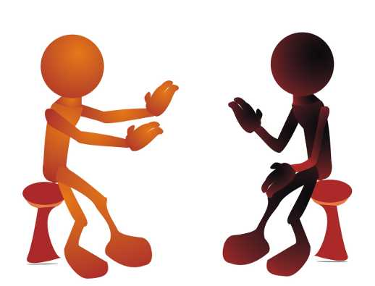
Accommodation
one party simply gives in to the other party
Avoidance
two parties try to ignore the problem and do nothing to resolve the disagreement

Slide 12
Competition
each party tries to maximize its own gain and has little interest in understanding the other’s position

